Slide 1

Linux kernel using git KERNEL (3.19.0 - 4.10.8(stable version))
Guidance of MRS.A.RAMA.
Submitted by
Name : M.A.MOHIDEEN ABDUL KHADER,S.LINGESH
Register No : U14IT010,U14IT007

Slide 2
ABSTRACT
The kernel objects streamed to git repository:-The meta-linux-kernel-extras git repository contains metadata needed only if you are modifying and building the kernel image.
It contains the kernel upstreams(cd /Desktop/linux/.git/sudo git fetch upstream) files that helps to edit to point to your locally modified kernel source files and to bulid the kernel image.
It required to a download of the kernel’s source files from upstream each time you make changes to the kernel.

Slide 3
INTRODUCTION
The Linux kernel is a monolithic unix -like computer operating system kernel.
The linux kernel API, the application programming interface (API) through which user programs interact with the kernel, is meant to be very stable and to not break user space programs (some programs, such as those with GUIs, rely on other APIs as well) .
The Linux kernel, developed by contributors worldwide, is a prominent example of free and open source software Day-to-day development discussions take place on the linux kernel mailing list(LKML). The Linux kernel is released under the GNU(general public licenses version 2 (GPLv2), with some firmware image released under various non-free licenses.

Slide 4
SYSTEM SPECIFICATION
HARDWARE REQUIREMENTS
Processor : Intel core i3 or above
Clock speed : 500 MHZ
System bus : 64 bits
RAM : 4098 MB of RAM
HDD : 120 GB or higher
Monitor : LCD Monitor
Keyboard : 108 keys
Mouse : Two Button mouse (left and right click mouse)
SOFTWARE REQUIREMENTS
Operating Systems : Ubuntu (any linux version)
Software Packages : gcc-4.9,g++-4.9,open SSL,qemu,lib5cursesw and git
(Ensure That These
Versions Or Higher
Versions Are Installed)

Slide 5
giT
Git is a widely used source code management system for software development
This new version of kernel has been developed by using GIT(it’s also using mool kernel version)
It is done by cloning it from the source repository using the command –
“ git clone ”

Slide 6
KERNEL COMPILATION
Move to the directory which is download by using the command –
“cd directory_name”
Compile the 3.18.3 kernel which was cloned in the following way
Initially run the command - “ make menuconfig”
This command allows the user to choose the features of the Linux kernel and other options that will be compiled
Give the support of corresponding feature by enabling the module as required
If we use [ * ] it treats as an inbuilt thing
If we use [ M ] it treats as a module
If we left empty [ ] it takes as it is not initialised and no impact of it in the kernel

Slide 7
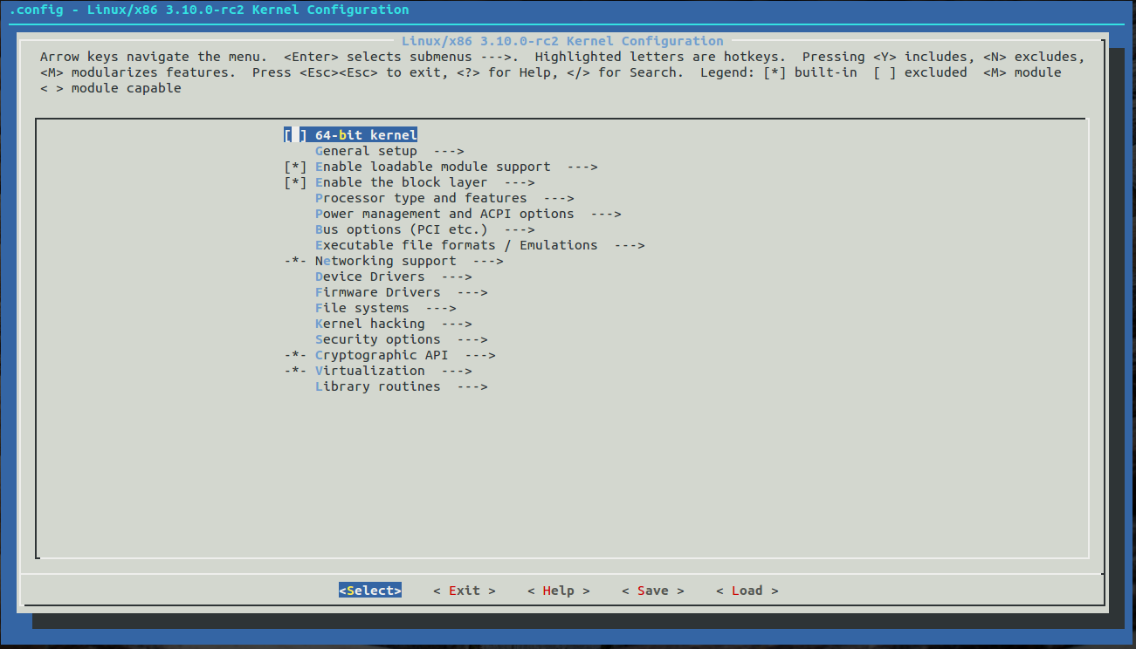

Slide 8
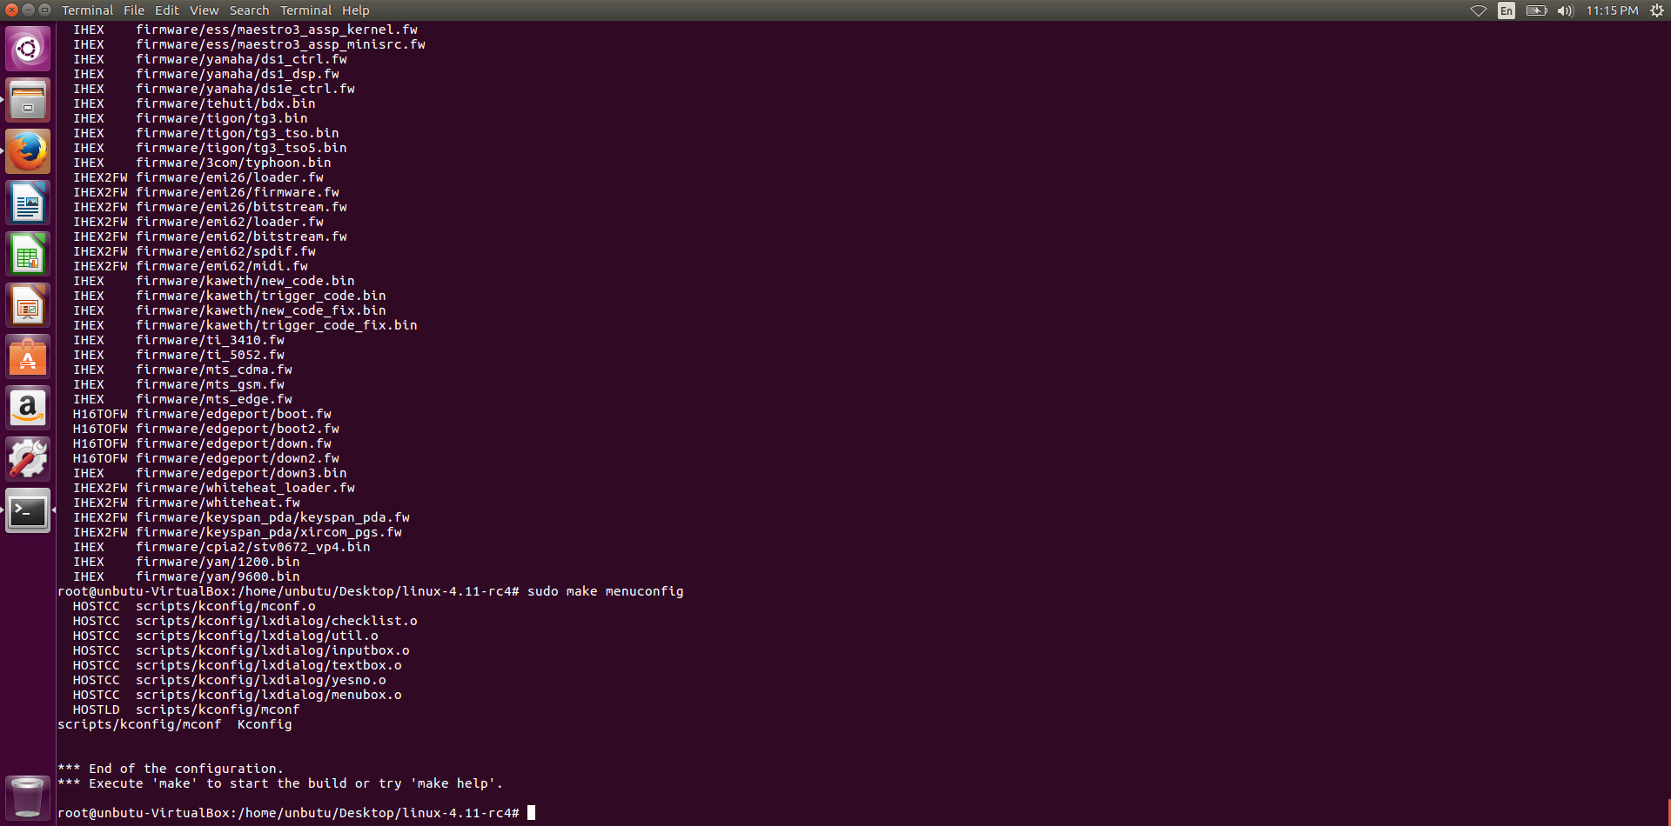

Slide 9
After enabling the required modules give the command –
“ make ”
It is used as a build automation tool that automatically builds executable programs and libraries from source code by reading files called Makefiles which specify how to derive the target program
After the compilation give the command- “sudo make modules_install” to install the necessary modules
Next to this command give the command- “sudo make install ” which shows the compiled kernel version

Slide 10
Now generate the kernel version image by using the command-
“sudo mkinitramfs –o /boot/initrdimg- (generated kernel version)”
(cd /boot
sudo mkinitramfs -o initrd.img-3.18.3)
Update the generated kernel version to the grub by using the command-
“sudo update-grub”
Reboot the system and get into the new kernel version developed

Slide 11
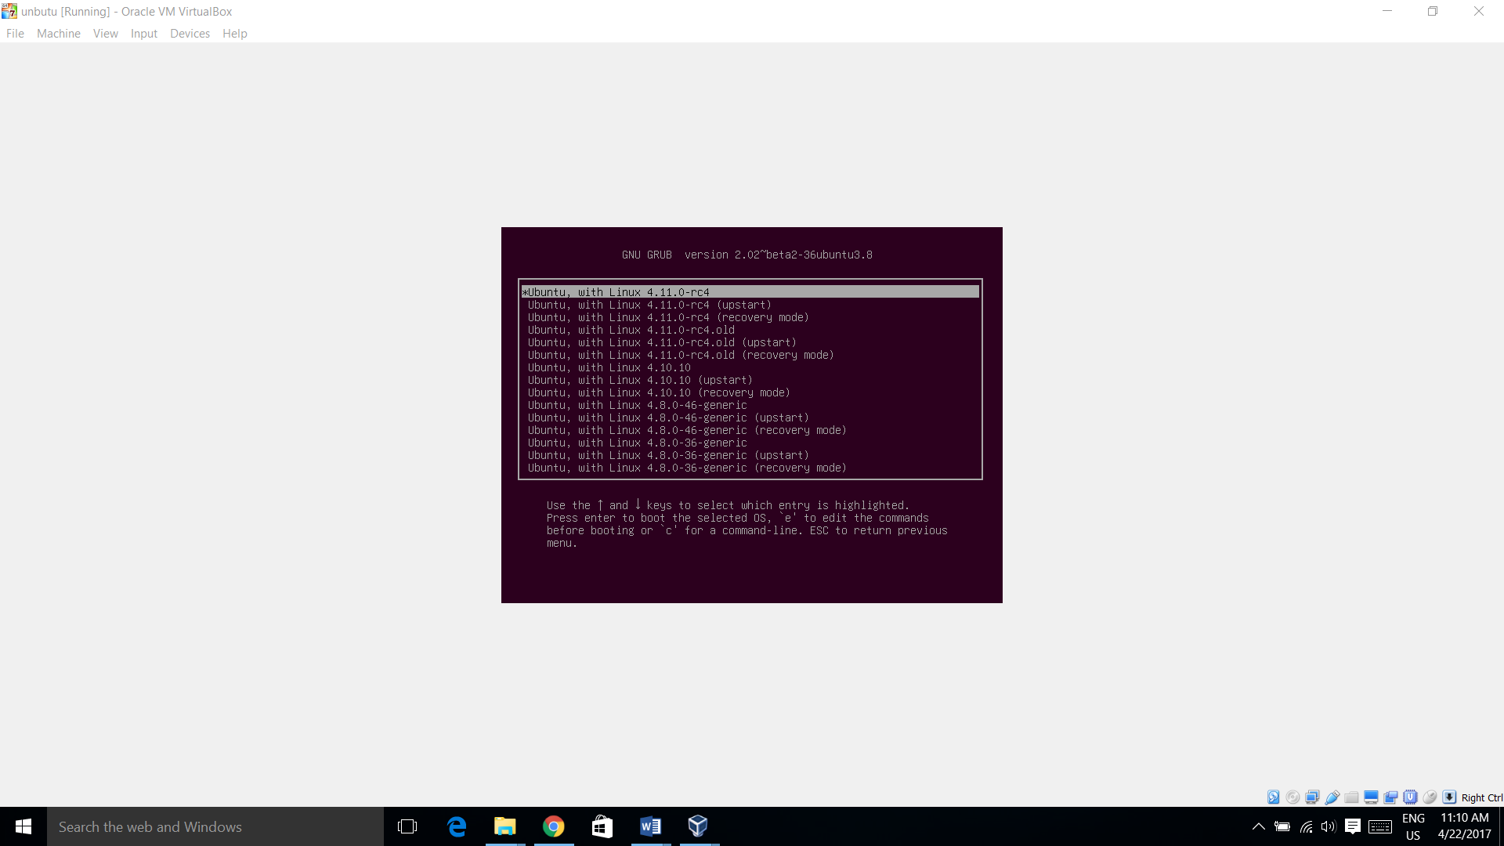

Slide 12
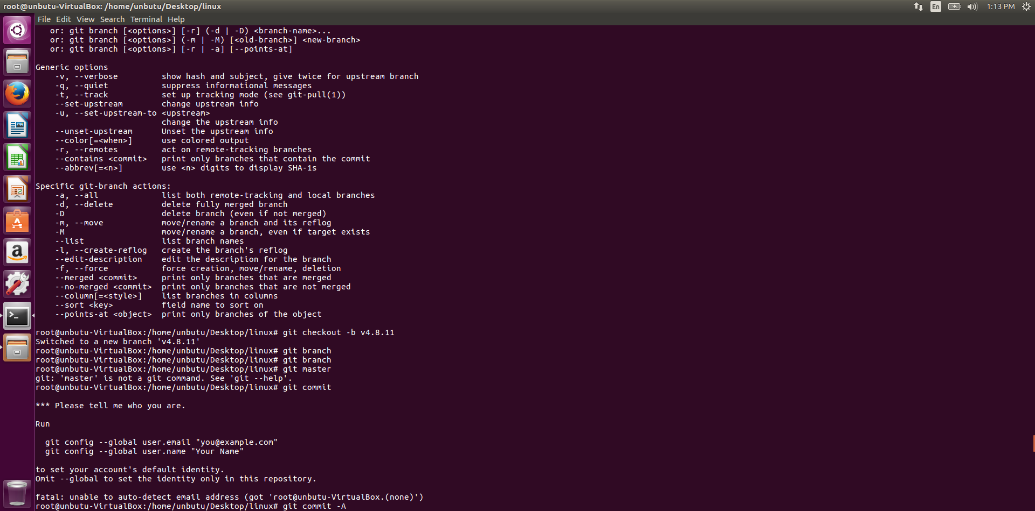

Slide 13
These conflicts are solved by removing the parenthesis
“<<<<<< head” and the text between the “====== and 3.18.9>>>>>>>>” by considering the mool changes and by including the header files
As head represents the current working branch i.e., 3.19.0 the code below it represents 3.19.0 so it should not be removed where as the code between “===== & 3.18.9 ” represents the 3.18.9 kernel can be removed as it is appended while the merging process
Again repeated the same procedure by giving the “make” command and generate the new kernel version 3.19.0
You can check the present booted kernel in the terminal by using the command
“ uname –a ”

Slide 14
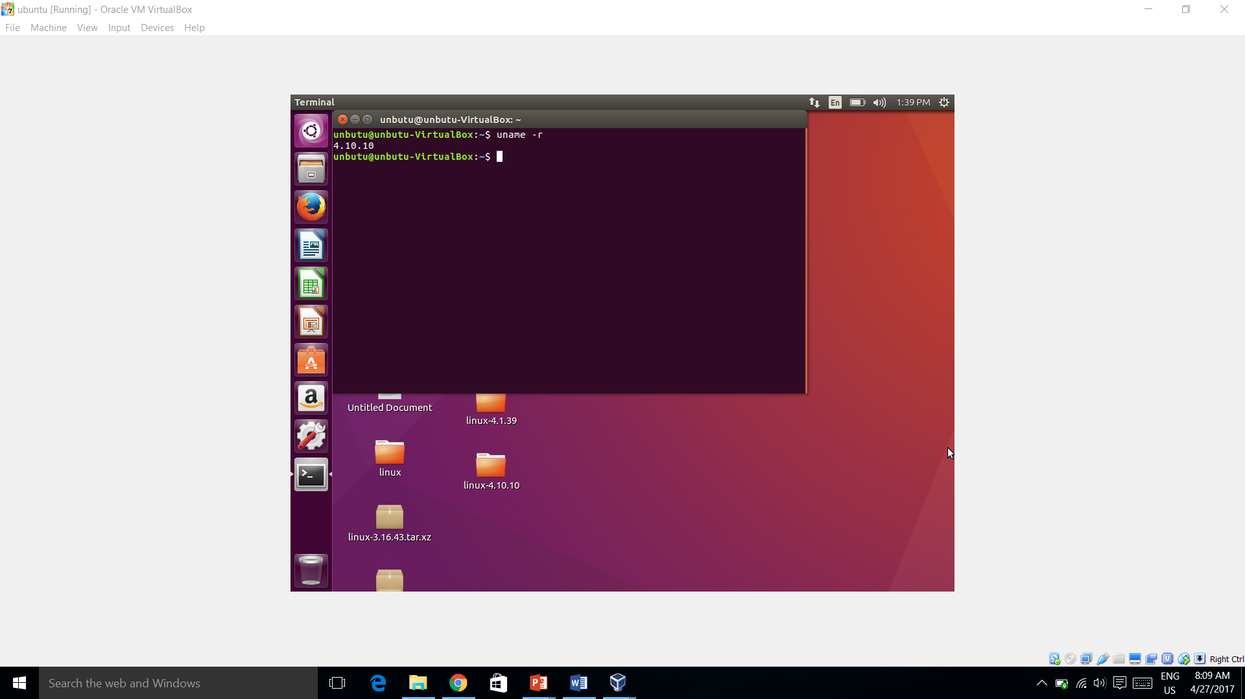

Slide 15
3.18.3(stable) - 3.18.9 – 4.10.8(stable)
To develop the new kernel first we have to take a new branch from the repository by using the command -
“git checkout branch_name”
If the branch is not present then we have to create it by using the command
“ git checkout -b branch_name ”
To check the current status of the working branch use the command -
“git status ”

Slide 16
The new files are added to the branch by using the command –
“ git add (filename) ” or “git add -A”
Then commit the changes to the branch by using the command-
“ git commit –m “first commit” ”
Then give the command - “make”
The following conflicts are araised while the compilation process takes place

Slide 17
Use the below command to merge the kernels
“git merge”
Later compile the 3.18.4 branch as if 3.18.3 and repeated the same process till 3.18.9 as there are no conflicts during the merging and compilation part
Now while merging the 3.18.9 branch with the 3.19 branch we get conflicts such as
- new files
-modified files
- both modified files

Slide 18
Git merge
cd directory (cd Desktop/linux)
sudo apt-get install git
sudo git inCommand for git merge
it
sudo git add
sudo git commit -am “testing”
cd .git(inside directory)
vi config(create a repository)
cd ..
sudo git fetch upstream
sudo git tag
sudo git checkout -b v4.10.10(any version)
sudo git branch
sudo git checkout -b vmaster
sudo git merge v4.10.10
sudo git status
Recomplier process

Slide 20
THANK YOU

